Slide 1

Designing Web APIs for Long Term Success
Or: The ways we painted ourselves into a corner.
Jeff Valore
Sr. Consultant NimblePros

Slide 2
Examples from 2 companies
🧠
🥚
B2B Enterprise SaaS vendor.
APIs for several Products converged into 1.
Business critical for clients. No downtime.
External clients often unwilling or unable to change.
Releases scheduled days in advance.
4 name changes, acquired twice in 8 years.
Internal APIs for Microservices.
Build by different teams.
Other teams often unaware of API changes.
Releases can happen as needed.

Slide 3
Document API Conventions (beyond Swagger)
Part 1 / 10
Drive API consistency across teams and products.
Customers (even internal ones) should know how to use the API. Support and Professional Services teams should be able to help customers build integrations.
Should define conventions:
How to use Authentication tokens.
Common query string parameters.
Common property names.
API response format.
Error handling.

Slide 4
Prior Art
JSON:API - https://jsonapi.org/
OpenAPI - https://spec.openapis.org/oas/v3.1.0
Stripe - https://docs.stripe.com/api
For an easier starting point, extend one of these.
🧠 "Unless otherwise specified, refer to JSON:API"
🥚No guidelines

Slide 5
JSON:API Example
8.5 Sorting
A server MAY choose to support requests to sort resource collections according to one or more criteria (“sort fields”).
An endpoint MAY support requests to sort the primary data with a sort query parameter. The value for sort MUST represent sort fields.
GET /people?sort=age HTTP/1.1 Accept: application/vnd.api+json
An endpoint MAY support multiple sort fields by allowing comma-separated (U+002C COMMA, “,”) sort fields. Sort fields SHOULD be applied in the order specified.
GET /people?sort=age,name HTTP/1.1 Accept: application/vnd.api+json

Slide 6
Return an Object, not an Array
Part 2 / 10
👎
👍
[
1, 2, 3, 4, 5
]
{
"data": [1, 2, 3, 4, 5],
"pageNumber": 1,
"pageSize": 5,
"total": 10,
"error": null
}

Slide 7
GraphQL Responses are always objects
Success:
{ "data": { "heroes": { "name": "R2-D2" } } }
Error:
{ "errors": [ { "message": "Syntax Error: Unexpected Name \"operation\".", "locations": [ { "line": 1, "column": 1 } ] } ] }

Slide 8
curl --request GET --url "https://api.github.com/user/repos"
[ { "id": 28718607, "name": "Code-Workshop", … } ]
curl --request GET --url "https://api.github.com/user/repos" -s | jq ".[0].name"
"Code-Workshop"

Slide 9
curl --request GET --url "https://api.github.com/user/repos" -s | jq ".[0].name"
jq: error (at <stdin>:5): Cannot index object with number

Slide 10
curl --request GET --url "https://api.github.com/user/repos" -s | jq ".[0].name"
jq: error (at <stdin>:5): Cannot index object with number
Response for an invalid / expired auth token:
{
"message": "Bad credentials", "documentation_url": "https://docs.github.com/rest", "status": "401" }

Slide 11
💬 Adding Pagination
GET /api/boards/7/remaining_images?page=2
[ {…}, {...} ]

Slide 12
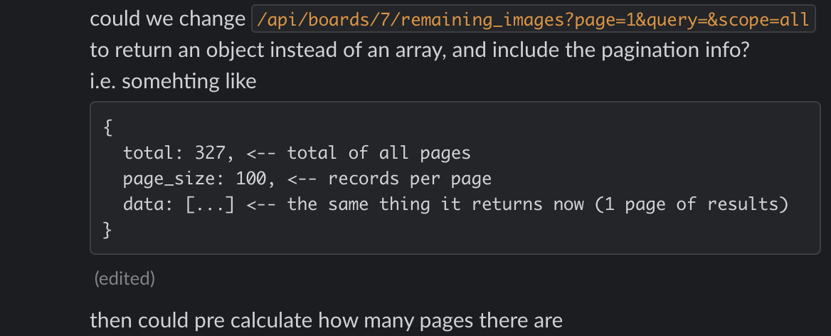
💬 Adding Pagination
GET /api/boards/7/remaining_images?page=2
[ {…}, {...} ]

Slide 13
JSON:API
7.1 Top Level
A JSON object MUST be at the root of every JSON:API request and response document containing data. This object defines a document’s “top level”.
A document MUST contain at least one of the following top-level members:
data: the document’s “primary data”.
errors: an array of error objects.
meta: a meta object that contains non-standard meta-information.
a member defined by an applied extension.
The members data and errors MUST NOT coexist in the same document.

Slide 14
Return Errors in a consistent way
Part 3 / 10
HTTP response codes where applicable.
{ "message": "Bad credentials", "documentation_url": "https://docs.github.com/rest", "status": "401" } What about i18n?
Possibly return an error ID that can be looked up.
Possibly translate error message based on "Accept-Language" request header

Slide 15
🥚
curl -X POST 'https://egg/api' -v / -H 'Content-Type: application/json' / -H 'accept: application/json' / -d '{ "numberField": "not a number. uhoh…" }'
400 Bad Request?

Slide 16
🥚
curl -X POST 'https://egg/api' -v / -H 'Content-Type: application/json' / -H 'accept: application/json' / -d '{ "numberField": "not a number. uhoh…" }'
< HTTP/2 500 < server: awselb/2.0 < content-type: test/plain; charset=utf-8 < Internal Server Error

Slide 17
🧠
Validation errors were returned in Rails ActiveRecord validator format…
class Person < ApplicationRecord validates :first_name, presence: true, length: { minimum: 3, maximum: 10 } end
{ "error": { "first_name": [ "Min length is 3", "Max length is 10" ] } }

Slide 18
Be Language Agnostic
Part 4 / 10
Validation errors were returned in Rails ActiveRecord validator format…
class Person < ApplicationRecord validates :first_name, presence: true, length: { minimum: 3, maximum: 10 } end
{ "error": { "first_name": [ "Min length is 3", "Max length is 10" ] } }

Slide 19
🥚
Rely on your documented conventions, not the conventions of a specific framework.
{
"data": {
"applicationId": "...",
"applicationNumber": "...",
"CallExp": "...",
"EXP_SUBCODE2": "...",
"EventType": "...",
…
}
}
{
"ApplicationNo": "...",
"AppStep": "...",
"Status_Attributes": {...},
"SystemErrors": {...},
"offers": [...],
"product": {...},
…
}

Slide 20
Document for Consistency
Property name casing (camel, snake, title)
Common property names ("applicationId", "userId", "orderId")
Data types (is applicationId a string, a number, a guid?)
Date formats (Numeric ms since epoch? ISO 8601 string?)

Slide 21
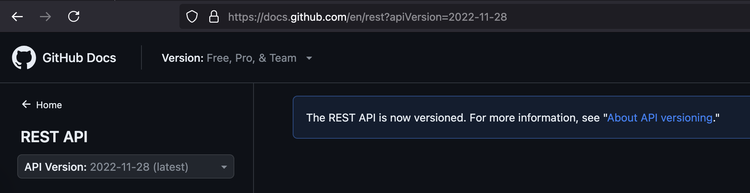
Versioning
Part 5 / 10
You should actually do it. Don't worry, everyone forgets…

Slide 22
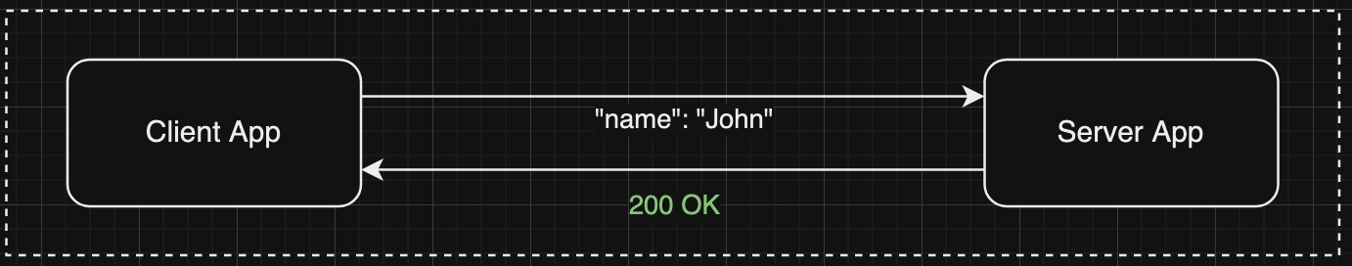
Change Version When Schema Has Breaking Changes
🥚 If an API sees extra fields it doesn't know about, it returns HTTP 400 Bad Request.
{
"name": "John"
}
{
"name": "John",
"age": 21
}

Slide 23
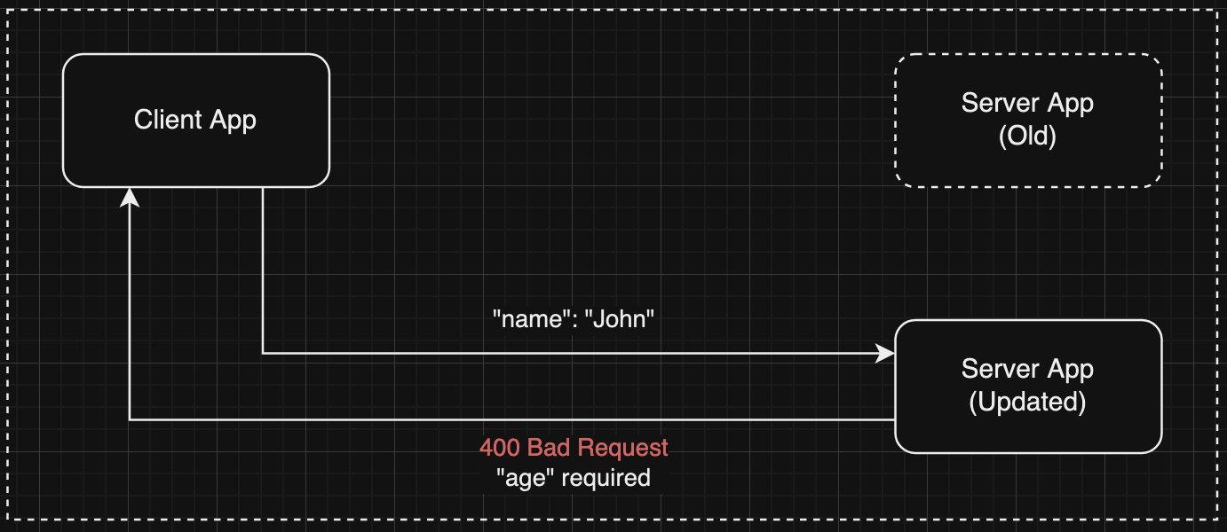
Can't deploy Server change first

Slide 24
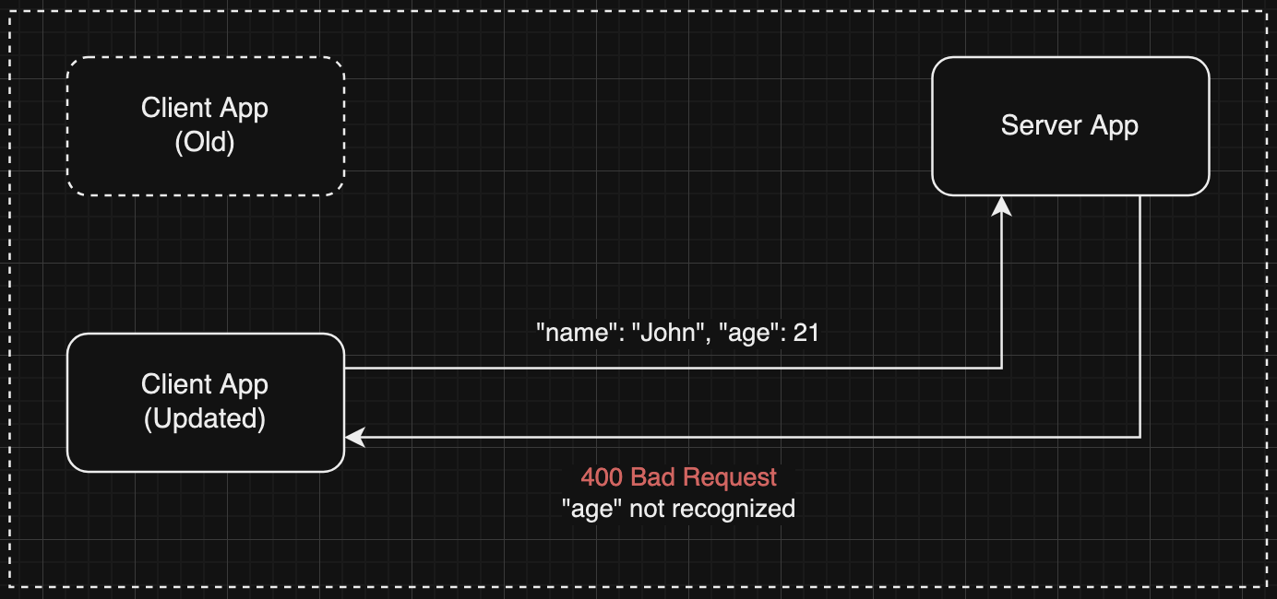
Can't deploy Client change first

Slide 25
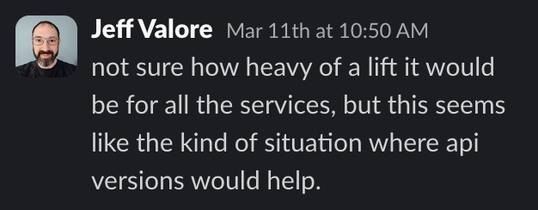
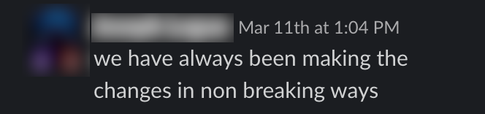
🥚

Slide 26
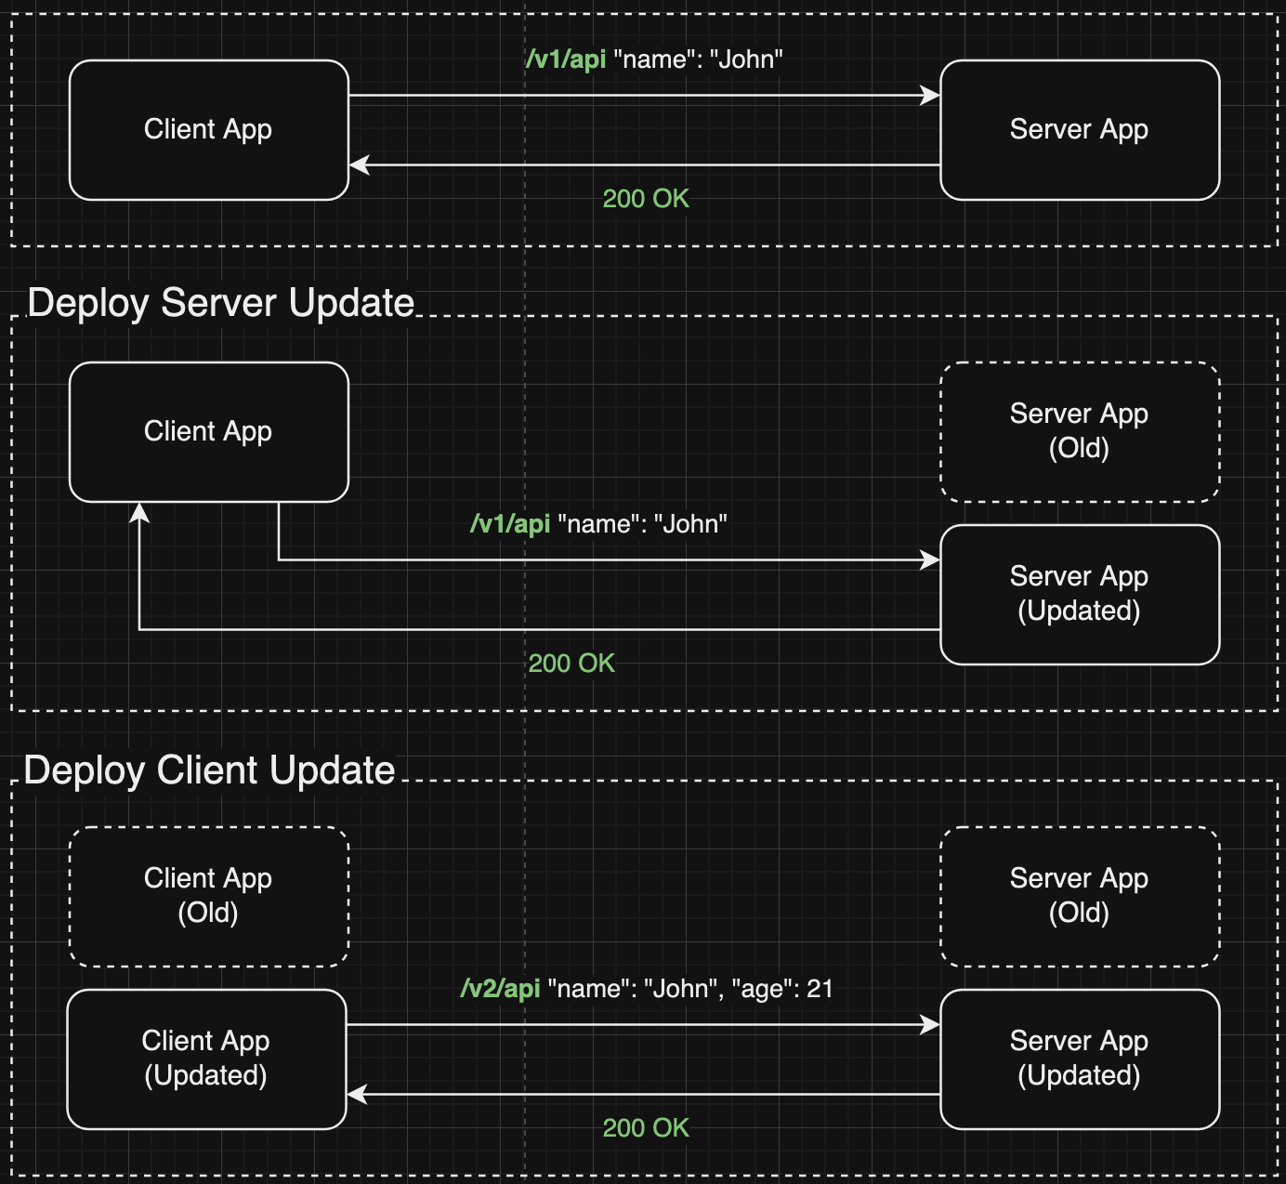

Slide 27
Versioning Styles
URL style:
curl "https://www.strava.com/api/v3/activities"
HTTP header style:
curl -H "X-GitHub-Api-Version:2022-11-28"
Belt & Suspenders style?
curl "https://api.stripe.com/v1/charges" -H "Stripe-Version:2024-06-20"

Slide 28
What about GraphQL?
https://graphql.org/learn/best-practices/#versioning
“GraphQL takes a strong opinion on avoiding versioning by providing the tools for the continuous evolution of a GraphQL schema.
GraphQL only returns the data that’s explicitly requested, so new capabilities can be added via new types and new fields on those types without creating a breaking change. This has led to a common practice of always avoiding breaking changes and serving a versionless API.”
… but what about mutations, or removal of a type, or renaming of properties?

Slide 29
Infrastructure as Code (IaC) and DNS
Part 6 / 10
# Example API Gateway with custom domain.
resource "aws_api_gateway_domain_name" "example" {
certificate_arn = aws_acm_certificate_validation.example.certificate_arn
domain_name = "api.example.com"
}
resource "aws_api_gateway_base_path_mapping" "example" {
api_id = aws_api_gateway_rest_api.example.id
domain_name = aws_api_gateway_domain_name.example.domain_name
}
# Example DNS record using Route53.
resource "aws_route53_record" "example" {
name = aws_api_gateway_domain_name.example.domain_name
type = "A"
zone_id = aws_route53_zone.example.id
alias {
evaluate_target_health = true
name = aws_api_gateway_domain_name.example.cloudfront_domain_name
zone_id = aws_api_gateway_domain_name.example.cloudfront_zone_id
}
}
🧠 Remember those 4 company renames? Now prod has 4 domain names and QA has 1.
IoC differences between envs hard to manage.
App rewrites use same domain. Conflict between apps.

Slide 30
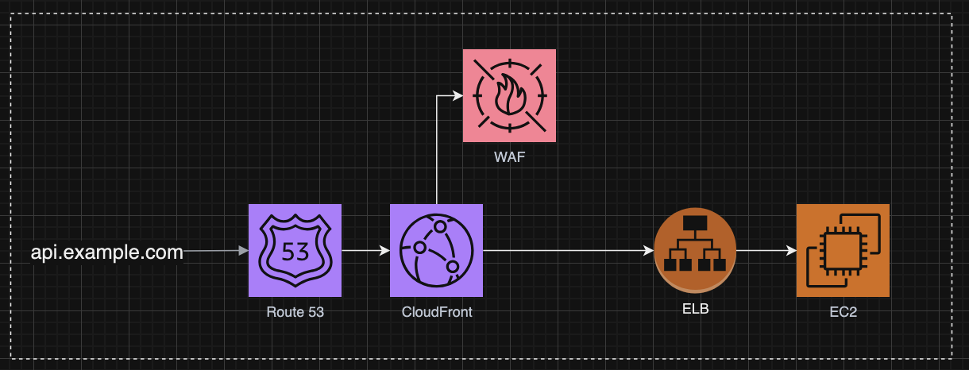
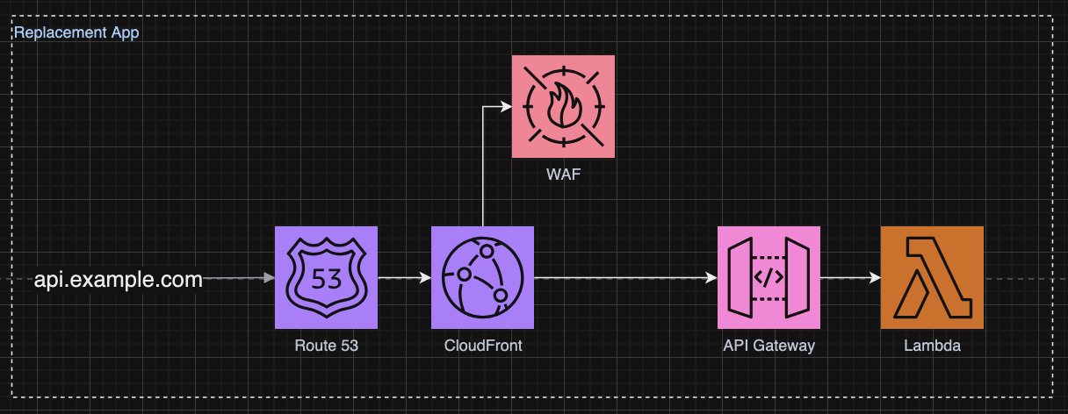
🧠

Slide 31
Infrastructure as Code (IaC) and DNS
Since domain names should stay the same for any rewrite of the app or multiple deployments, DNS IoC should not be owned by the app. Move it to its own IoC “project”

Slide 32
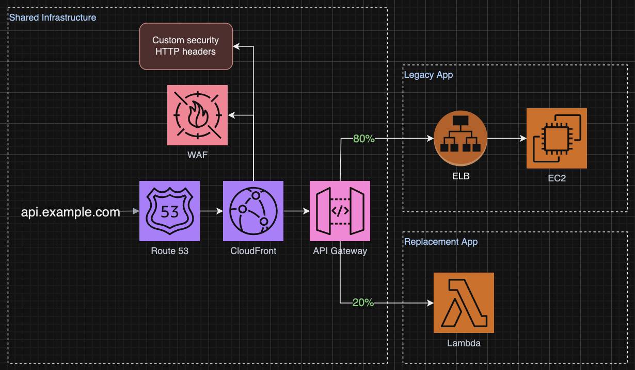

Slide 33
Don't assume all requests are going to the same application. Traffic could route to different systems.
Part 7 / 10
Use an API Gateway to route traffic to a backing application.
🧠 Tenants were migrated 1 at a time to a new application, with no change of URL.

Slide 34
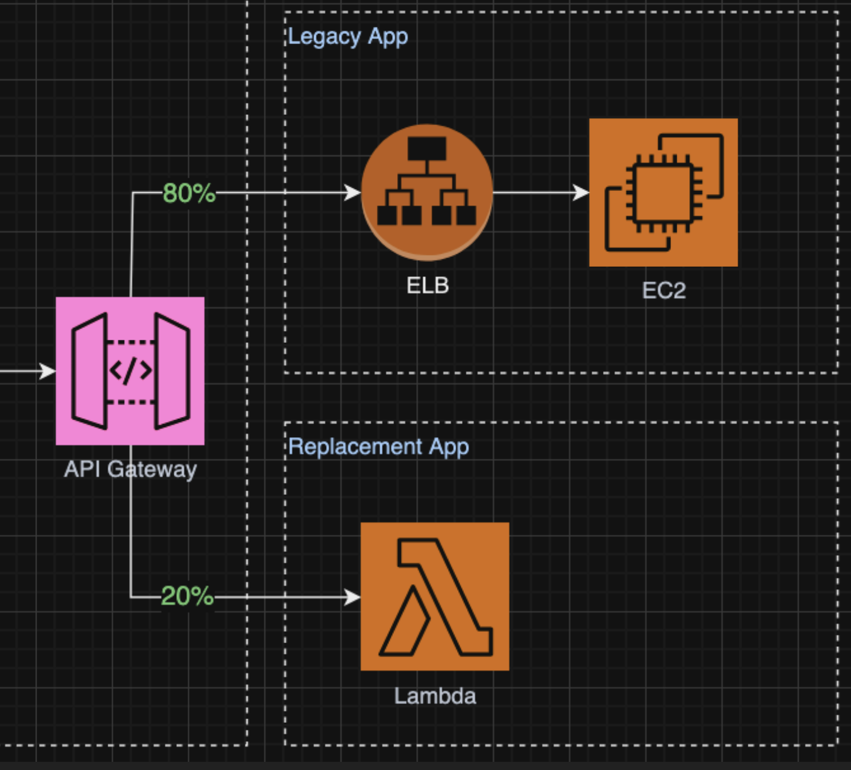
Use an API Gateway to route traffic (the pattern, not necessarily the aws product)
By Version
By Tenant / Customer
By A/B test groups (canary deploys)
Without your clients having to change the way they call your API.

Slide 35
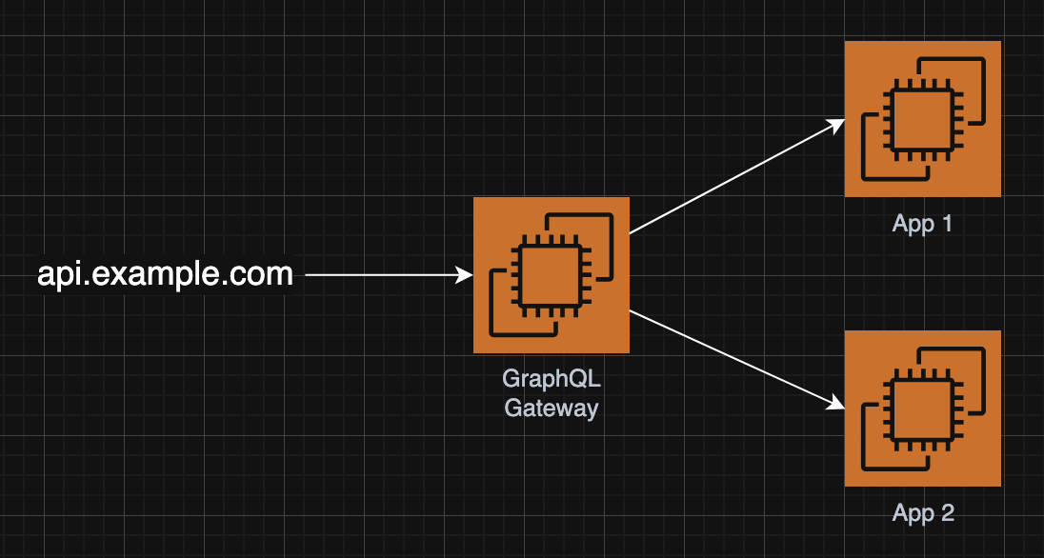
Example: Federated GraphQL
🧠

Slide 36
Move common functionality forward
Part 8 / 10
Authentication / Access control
Traces and Metrics (requests rates, failure rates, duration)
Rate Limiting
DDoS prevention
You shouldn't have to re-implement these things for each new service.

Slide 37
Observability: Dashboards, Alerting, and SLAs/SLOs
Part 9 / 10
How do you know your API is working?
Performance metrics & traceability built in up front
Add dimensions to track individual clients/customers, and requests per route
API Version as a dimension to know when an older version can be deleted.
🧠 Had good GraphQL metrics (until they were deleted) but no tracing.
🥚 Good dashboards and tracing. Easier to troubleshoot production.

Slide 38
Use Dimensions to slice your data
"Show me [metric] per [dimension]"
Requests Latency
Errors
Path
Version Tenant
User

Slide 39
In ExpressJS & DataDog
const perfHooks = require('node:perf_hooks');
const tracer = require('dd-trace');
app.use((req, res, next) => {
const metricTags = gatherMetricTags(req);
const start = perfHooks.performance.now();
try {
next();
} catch (error) {
metricTags.error = true;
} finally {
const duration = perfHooks.performance.now() - start;
tracer.dogstatsd.gauge('api_handler', duration, metricTags);
}
});
function gatherMetricTags(req) {
return {
environment: process.env.ENV,
path: req.originalUrl,
version: req.headers['x-version'] || 'unknown',
tenant: req.headers['x-tenant-id'] || 'unknown',
user: req.userId || 'unknown',
error: false,
};
}

Slide 40
public class ApiAsyncTraceActionFilter : Microsoft.AspNetCore.Mvc.Filters.IAsyncActionFilter
{
public async Task OnActionExecutionAsync(ActionExecutingContext context, ActionExecutionDelegate next)
{
using var _scope = Tracer.Instance.StartActive("HandleAsync");
try
{
AddDataToScope(context);
}
catch { /* Intentionally ignoring errors. */ }
try
{
await next();
}
catch (Exception ex)
{
_scope.Span.SetException(ex);
throw;
}
}

Slide 41
private readonly string[] _autoIncludeProperties = [ "userid", "accountid", "customerid", "orderid" ];
private void AddDataToScope(ActionExecutingContext context)
{
_scope.Span.ResourceName = context.Controller.GetType().FullName;
_scope.Span.SetTag("Request Method", context.HttpContext.Request.Method);
_scope.Span.SetTag("Request Path", context.HttpContext.Request.Path);
if (context.ActionDescriptor.Parameters.Count > 0)
{
var requestParameter = context.ActionDescriptor.Parameters[0];
var requestType = requestParameter.ParameterType;
var props = requestType.GetProperties(BindingFlags.Instance | BindingFlags.Public);
foreach (var prop in props.Where(p => _autoIncludeProperties.Contains(p.Name.ToLower())))
{
try
{
_scope.Span.SetTag(
prop.Name,
prop.GetValue(context.ActionArguments[requestParameter.Name])?.ToString() ?? "null"
);
}
catch { /* Intentionally ignoring errors. */ }
}
}
}

Slide 42
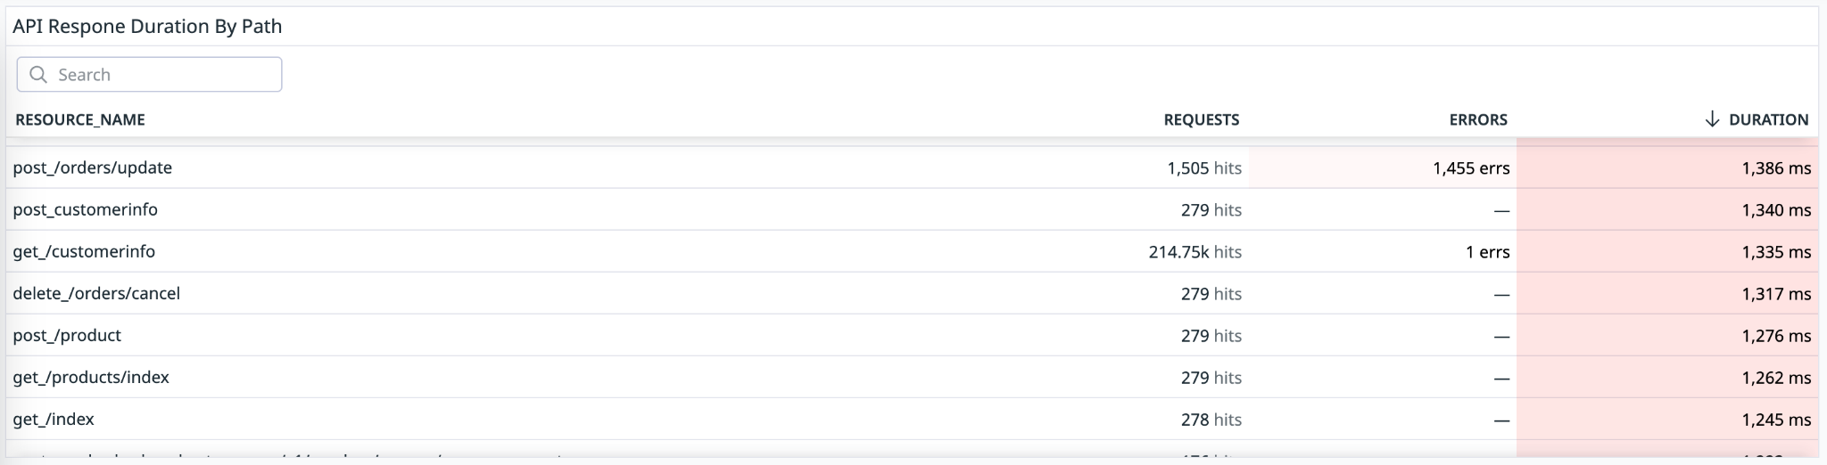
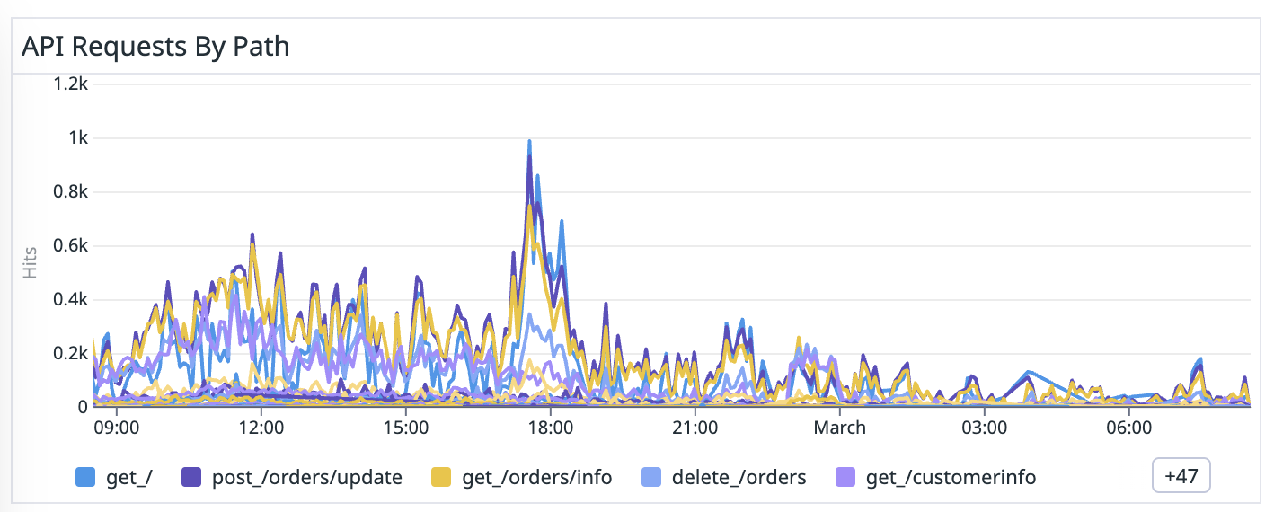

Slide 43
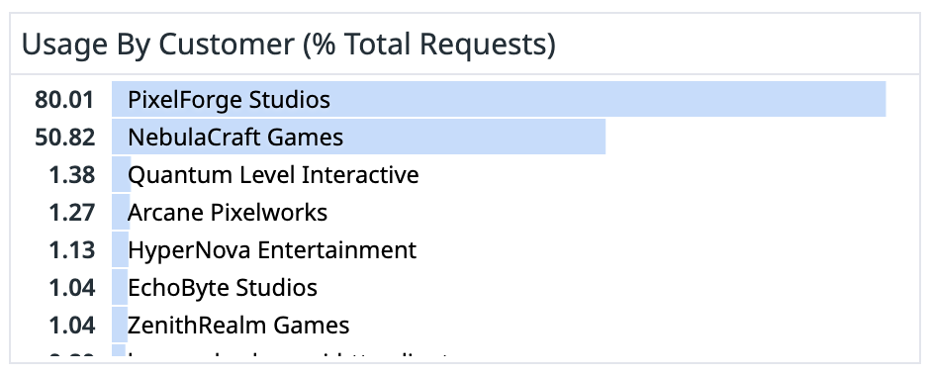
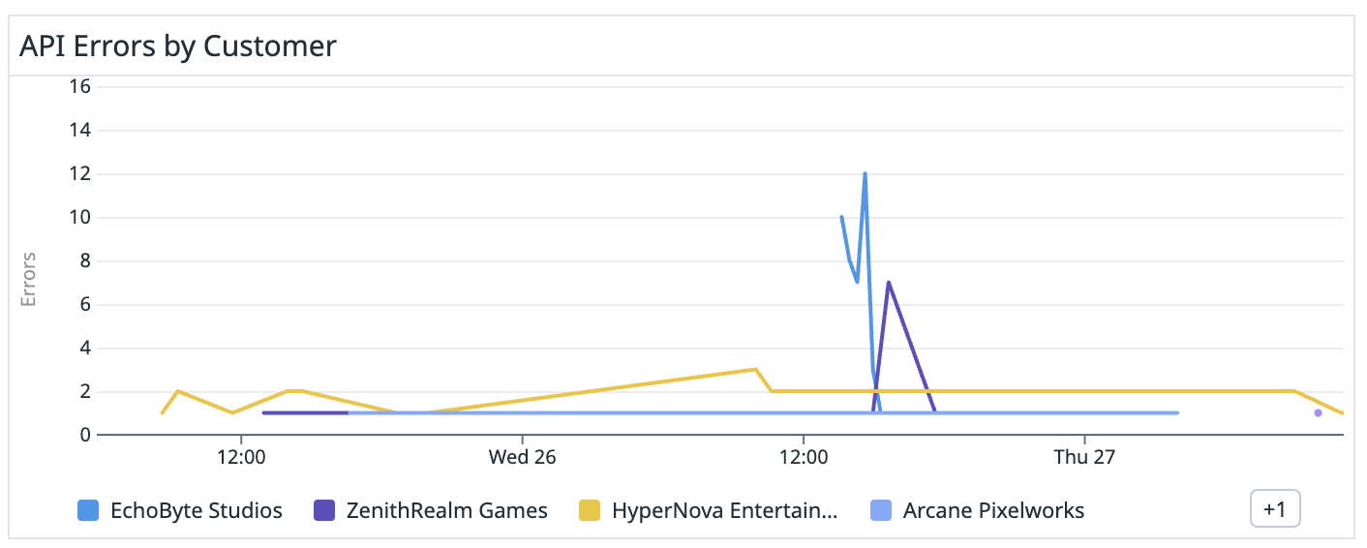
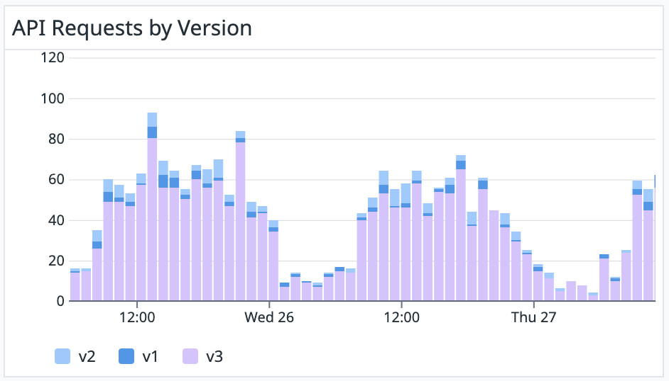

Slide 44
Idempotency
Part 10 / 10
Support a way for customers to repeat duplicate requests and expect idempotency.
curl https://api.stripe.com/v1/customers \ -H "Idempotency-Key: abc123"

Slide 45
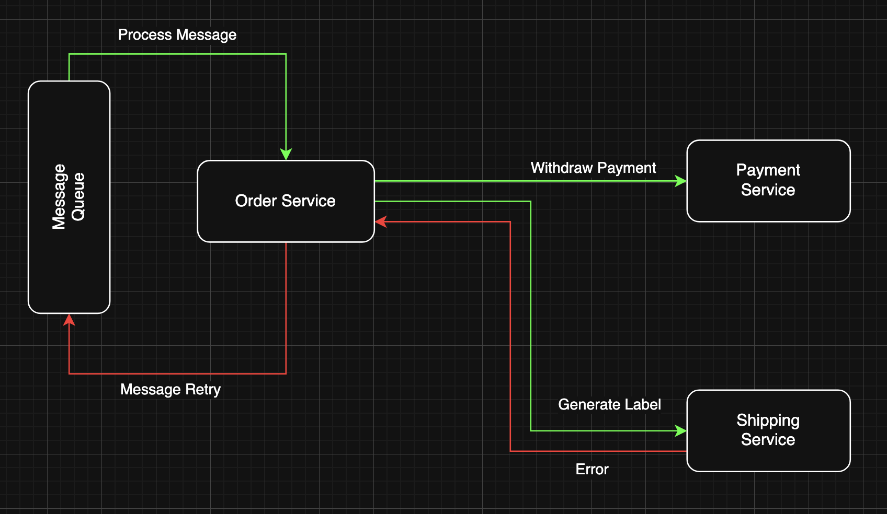
API Call Idempotency

Slide 46
Designing Web APIs for Long Term Success
Document conventions
Return Objects, not Arrays
Return Errors in a well documented, consistent way
Be language agnostic
Include versioning
Handle shared infrastructure and DNS in a separate IaC project
Plan for future replacement. Use an API Gateway or proxy to route traffic
Move shared functionality forward in the stack
Build common Observability patterns, dashboards, & track SLAs
Consider Idempotency

Slide 47
Designing Web APIs for Long Term Success
Jeff Valore
Sr. Consultant NimblePros

